Slide 1
Capstone Engagement
Assessment, Analysis, and Hardening of a Vulnerable System
Sofia Gaglione

Slide 2
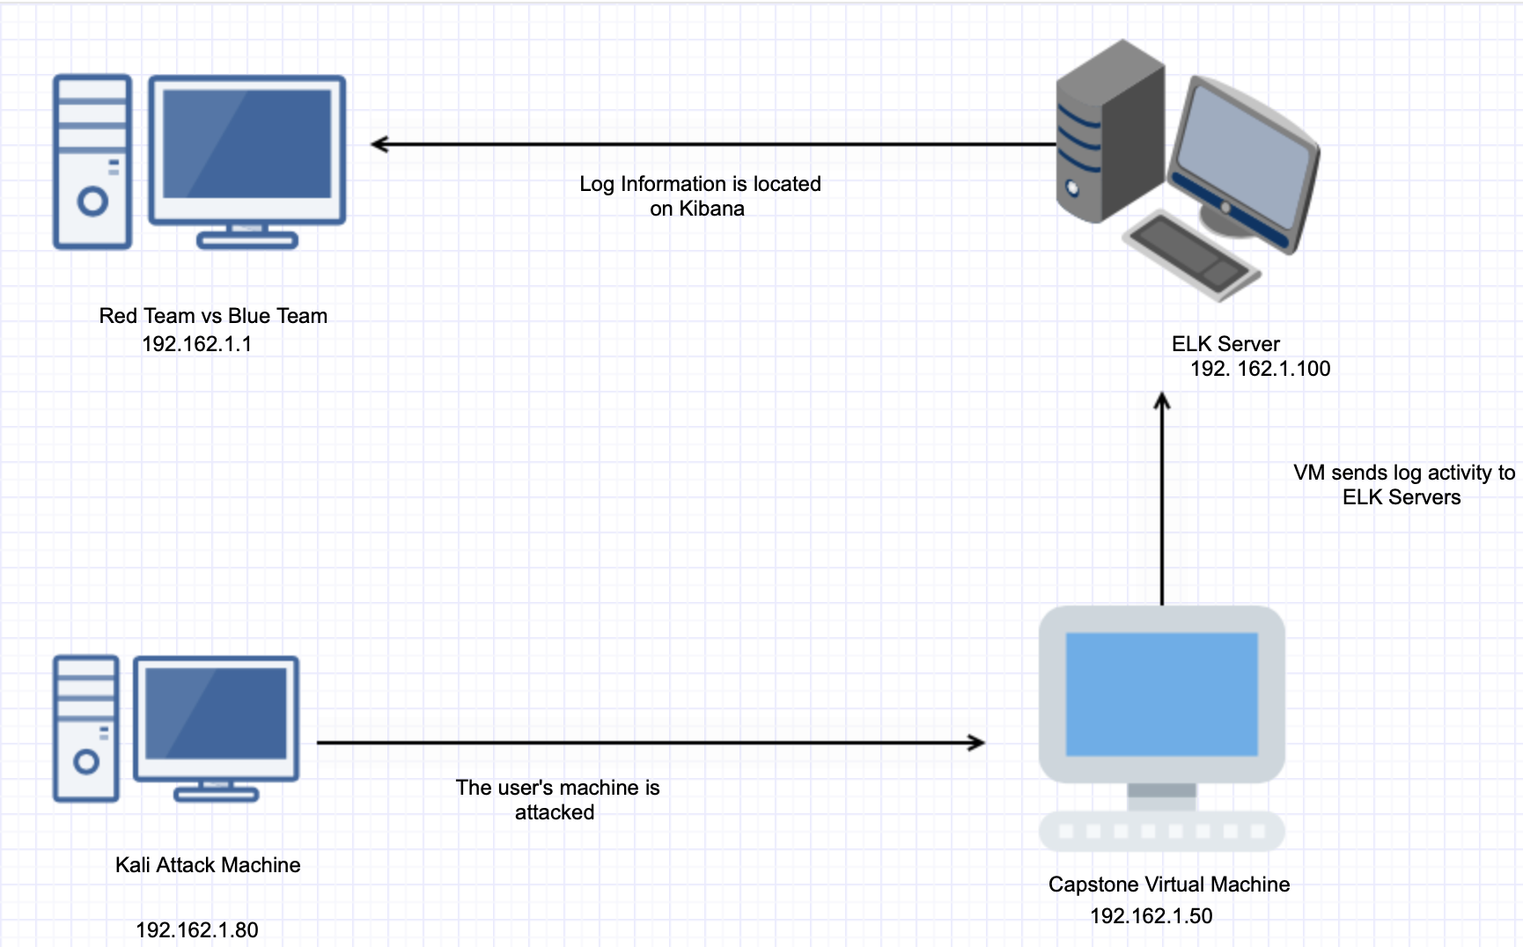
Topology
Network
Address Range:
Netmask: 255.255.255.0
Gateway: 192.162.1.80
Machines
IPv4: 192. 162.1.100
OS: Linux
Hostname: ELK
IPv4: 192.162.1.50
OS: Linux
Hostname:Capstone
IPv4: 192.162.1.80
OS: Windows
Hostname: Red vs Blue
IPv4: 192.162.1.1
OS: Linux
Hostname: Kali

Slide 3
Red Team: Describing the Target
Hostname | IP address | Name of Network
Red vs Blue | 192.162.1.80 | Host Machine
Capstone | 192.162.1.50 | Vulnerable Machine
ELK Kali | 192. 162.1.100 192.162.1.1 | Log Activity is found in Capstone Machine Attack Machine

Slide 4
Red Team: Vulnerability Assessment
Vulnerability | Description | Impact
Open Files | Records are coordinated by putting away related documents in a similar registry. | You are able to get access to secret files using the IP addresses found.
Port 80 | Open port is utilized to mean a TCP or UDP port number that is arranged to acknowledge bundles. | We were able to access the user’s usernames and passwords
Brute Force Password | A brute-force attack assault comprises of an assailant submitting numerous passwords with the desire for at last speculating a blend accurately. | We were able to obtain secret files on the machine.

Slide 5
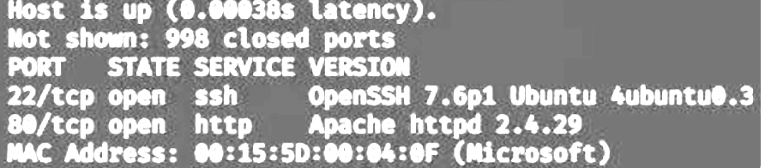
Red Team Exploitation: Port 80
Tools and Processes | Achievements | Image of Exploit
I used the nmap command to monitor any vulnerable ports in services in the network | The IP address was located, which had an opened port (80). With the open port, we were able to get the accessible files.

Slide 6
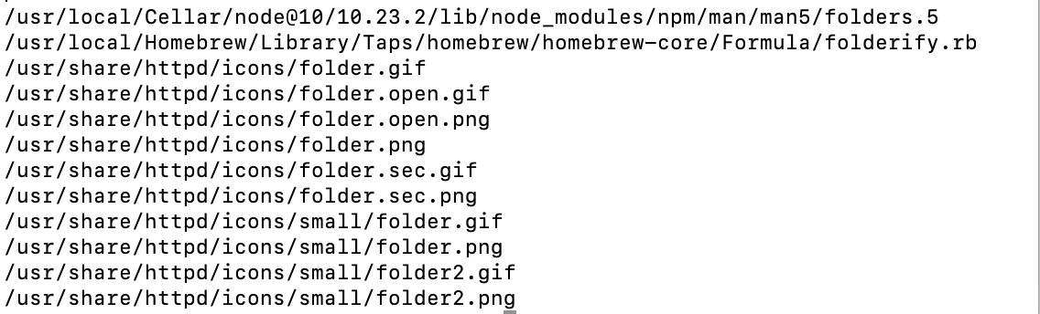
Red Team Exploitation: Brute Force Attack
Tools and Processes | Achievements | Image of Exploit
Hydra was used to brute force attack to unlock the password | We obtained access the secret files

Slide 7
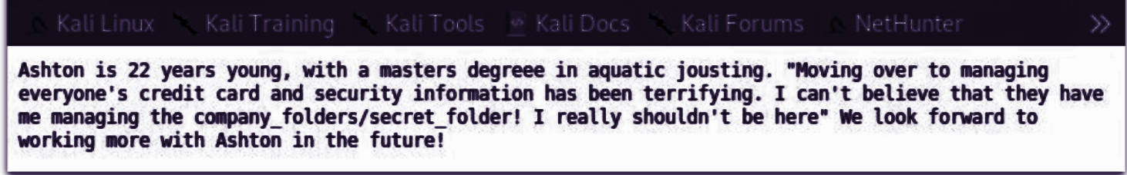
Red Team Exploitation: Open Files
Tools and Processes | Achievements | Image of Exploit
Port 80 was used to see if there were any important files. | Secret files were located.

Slide 8

Blue Team: Port Scan
Timing of Port Scan | How many packets were sent, and from which IP? | What indicates that this was a port scan?
5pm | 1,500 | Ping Scan puts in request from port 443.

Slide 9
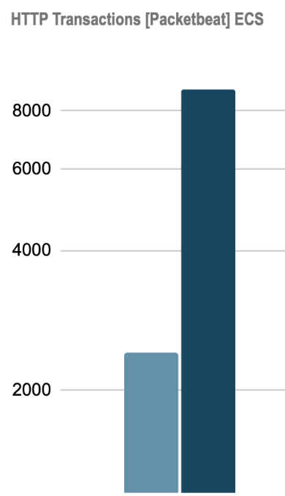
Blue Team: Finding the Request for the Hidden Directory
Time of Request and # | Files Requested? What did they have?
4pm | 8000

Slide 10
Blue Team: Brute Force Attack
How many requests in the attack? | # of requests made before the attack got the password?
5 | 7

Slide 11
Blue Team: Blocking The Port Scan
Alarm | System Hardening
What alarms can be set to detect future port scans? A TCP interface check would have to be trigger an caution on the IDS so there should be limit set accurately to decrease the number of untrue positives. UDP checks send a parcel to different ports on a target framework and assess the reaction to decide accessibility of the benefit and the have. What threshold should you set up to activate the alarm? Illustrate an alarm message by creating a security rule to activate the alarm. | What configurations can be set on the host to mitigate port scans? Install a Firewall TCP Coverings Describe the solution. If possible, provide required command lines. A firewall can help forestall unapproved admittance to a private organization. TCP covering can give heads the adaptability to allow or deny admittance to the workers dependent on IP locations or area names.

Slide 12
Blue Team: Request for Hidden Directory
Alarm | System Hardening
What alarms can be set to detect future unauthorized access? Rule-based alerts=security apparatuses can alarm safety crew to dubious movement designs, for example, numerous login endeavors or wrong login to touchy frameworks Log Analysis = security examiners can acquire perceivability into logs of delicate endeavor frameworks and uncover dubious movement What threshold should you set up to activate the alarm? Create a security rule to inhibit outbound traffic | What configurations can be set on the host to block unwanted access? Create an Internet Information Server to monitor the website of the associated user (s). Describe the solution. If possible, provide required command lines. IIS is a web worker programming bundle intended for Windows Worker. It is utilized for facilitating sites and other substance Online. Microsoft's Web Data Administrations gives a graphical UI (GUI) for overseeing sites and the related clients.

Slide 13
Blue Team: Brute Force Attacks
Alarm | System Hardening
What kind of alarm can be set to detect future brute force attacks? IP address lock-out Locking the account after a fixed number of failed attempts What threshold would you set to activate this alarm? Create a brute force attack protection | What configuration can be set on the host to block brute force attacks? Use Strong Passwords Confine Admittance to Validation URLs Describe the solution. If possible, provide the required command line(s). A necessity for savage power assaults is to send accreditations. On the off chance that you change the login page URL — for instance, moving from/wp-login.php to/mysite-login — this can be sufficient to stop generally robotized and mass instruments.

Slide 14
Blue Team: Detecting the WebDAV Connecti0n
Alarm | System Hardening
What kind of alarm can be set to detect future access to this directory? Create a VPN What threshold would you set to activate this alarm? Create a security rule that inhibits traffic from outbound sources | What configuration can be set on the host to control access? Setting Access Control for the Host-IP Describe the solution. If possible, provide the required command line(s). You determine have names or IP addresses for the PCs that you need to permit or deny. You can utilize trump card examples to indicate numerous PCs or whole organizations. Admittance to a document or registry utilizing Host-IP verification seems consistent to the client.

Slide 15
Blue Team: Identifying the Reverse Shell Uploads
Alarm | System Hardening
What kind of alarm can be set to detect future file uploads? Server-side virus scanners can detect file uploads that contain malware, trojans and viruses What threshold would you set to activate this alarm? Set up the anti-malware scanner to monitor viruses | What configuration can be set on the host to block file uploads? HTTP authentication Describe the solution. If possible, provide the required command line. Create a MySQL database with users table. Create a user login panel to submit login details to PHP Generate query to compare user login details with the MySQL user database

Slide 16
THE END

